Slide 1


Lecture 3: Data Science - Regression
COMP704: Machine Learning
MSc Artificial Intelligence for Games

Slide 2
Today’s session:
Deep dive into the regression learning approach
Learning trig through regression
Workshop

Slide 3
Deep dive into the regression learning approach

Slide 4
Deep dive into the regression learning approach
When to use regression?

Slide 5

Deep dive into the regression learning approach
When to use regression?
When inputs map to continuous outputs
Mariflow
Does not have this as inputs map to button presses

Slide 6
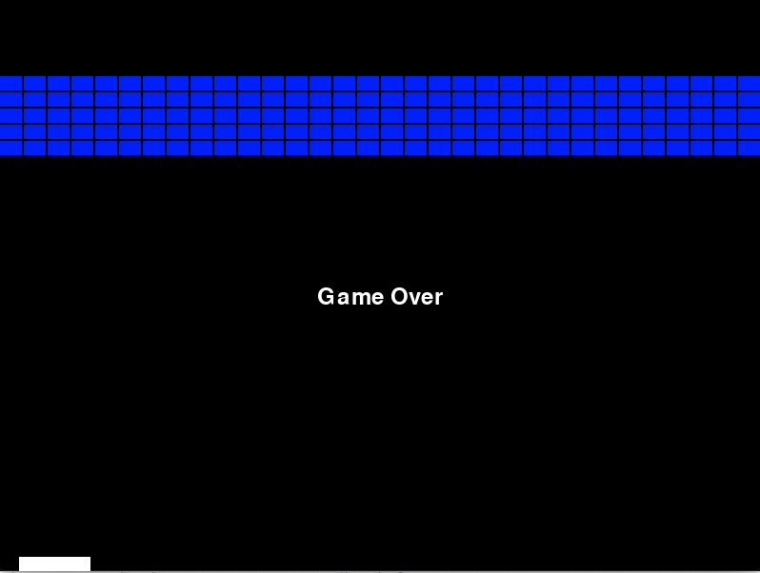
Deep dive into the regression learning approach
When to use regression?
When inputs map to continuous outputs
Crappy breakout
Could have this as inputs (the state of the world) can map to where the paddle should be (0… screen_x)
If we map inputs to button presses (move_left, move_right, do nothing), then regression is not a good fit for this learning

Slide 7
Deep dive into the regression learning approach
When to use regression?
When inputs map to continuous outputs
We can start to see that machine learning ( & data science) is about:
Data & learning algorithms
Rather than code
Need to spend a lot of our time thinking about the relationship between data and learning algorithms in order to solve our problems

Slide 8
Deep dive into the regression learning approach
The scikit-learn approach to regression
1. Get data into a form that can be used for training and testing
Typically, use pandas to load data into a dataframe object
Split the frame into
X – the inputs
Y – the output
Use scikit’s train_test_split to create training & testing datasets
X_train & Y_train – training inputs and outputs
Y_test & y_test – testing inputs & outputs
Data is randomised into groups to stop local clustering

Slide 9
Deep dive into the regression learning approach
The scikit-learn approach to regression
2. Choose and configure a training algorithm
For each type of training that scikit supports (regression, classification, clustering and dimensionality reduction) there are multiple algorithms
Part of ML is about choosing the most suitable algorithm (by trial and error)
The other part of ML is about configuring parameters (hyper parameters) -> remember what I said about genetic algorithms in week 1
Scikit website has lots of information about algorithm use cases

Slide 10
Deep dive into the regression learning approach
The scikit-learn approach to regression
3. Train the model
All (most) scikit algorthims perform this through model.fit(x_train, y_train)
This may involve having a cup of coffee

Slide 11
Deep dive into the regression learning approach
The scikit-learn approach to regression
4. Evaluate training results with test data
All (most) scikit algorthims perform this through model.fit(x_train, y_train)
This may involve having a cup of coffee

Slide 12
Deep dive into the regression learning approach
The scikit-learn approach to regression
5. Evaluate performance
Use the mean absolute error of training data & test data to give over-fit / under-fit analysis
Low error on training & high error on testing
Overfitted algorithm to learn test data by rote rather than learning generalisations
Change algorithm / change parameters
High error on training
Underfitted algorithm makes random outputs from data
Algorithm may not be a good fit for data
May not have enough data to train with

Slide 13
Deep dive into the regression learning approach
The scikit-learn approach to regression
5. Evaluate performance
You get to decide what constitutes low & high errors
What may be acceptable to one learning scenario may not be to another
This is where DS & ML meet
Error terms likely to be defined as business / domain requirements

Slide 14
Deep dive into the regression learning approach
The scikit-learn approach to regression
6. iterate or ship
Either iterate the training process or put the algorithm into ‘production’

Slide 15
Deep dive into the regression learning approach
The scikit-learn approach to regression
7. Ship
Save model as a pkl file
Write application around pkl data using model.predict
Will take X_frame data (from training) to produce results on novel data

Slide 16
Learning trig through regression

Slide 17
Learning trig through regression
Regression works when we have a continuous mapping from input(s) to output
Sine is a nice & simple example of that we can use to experiment with ML
Easy to get lots of data
Easy to process

Slide 18
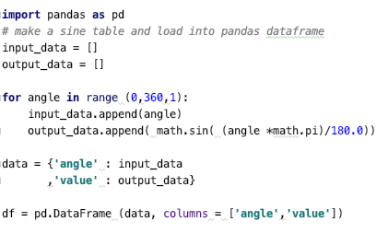
Learning trig through regression
1. Get data into a form that can be used for training and testing
We need to have our data organised as a table of input and output values
To generate the sine table data
https://datatofish.com/create-pandas-dataframe/

Slide 19
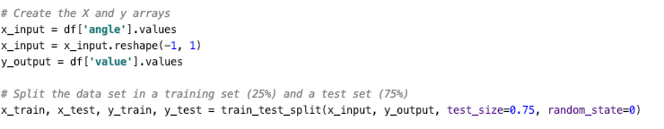
Learning trig through regression
1. Get data into a form that can be used for training and testing
To get the data into the x & y forms
Pandas doesn’t like 1-D data, so the reshape(-1,1) will put the data into a format it likes
https://stackoverflow.com/questions/35082140/preprocessing-in-scikit-learn-single-sample-depreciation-warning

Slide 20
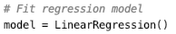
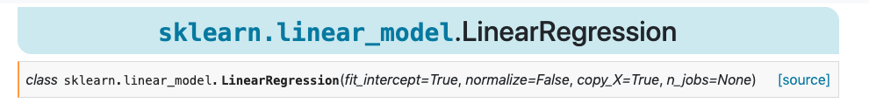
Learning trig through regression
2. Choose and configure a training algorithm
Let’s use linear regression
Typically, each ML algorithm will have attributes that help it learn. These can be set and configured as part of the ML process, though the default values should provide some learning
https://scikit-learn.org/stable/auto_examples/linear_model/plot_ols.html?highlight=linearregression

Slide 21
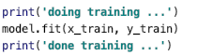
Learning trig through regression
3. Train the model
Again, scikit learning algorithms have a fairly common interface taking x_train (inputs) and y_train (outputs)
Assuming supervised learning

Slide 22
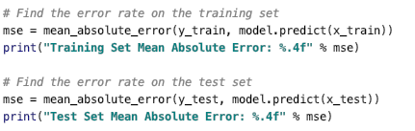
Learning trig through regression
4. Evaluate the outcomes

Slide 23
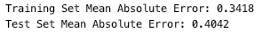
Learning trig through regression
5. Evaluate performance
What do these numbers mean?
Sine() ranges from -1 to +1
An error of 0.35 for the training data -> underfitting
Algorithm isn’t leaning
An error of 0.4 for the test data
Algorithm is junk

Slide 24
Learning trig through regression
6. iterate or ship
Iterate
Why is training so bad?
Can’t really do linear regression on non-linear data
Line of best fit (least errors) is y = 0

Slide 25
Learning trig through regression
6. iterate or ship
Iterate
Change algorithm to Gradient Boosting Regressor
Made for more complex & non-linear data
Data is stored in buckets of linear regression
https://scikit-learn.org/stable/modules/generated/sklearn.ensemble.GradientBoostingRegressor.html

Slide 26

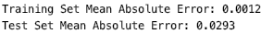
Learning trig through regression
6. iterate or ship
Iterate
Create a new model
Train it and get the results
Training error very low
Test error low, but higher than training
Might be worth tweaking the algorithm parameters

Slide 27
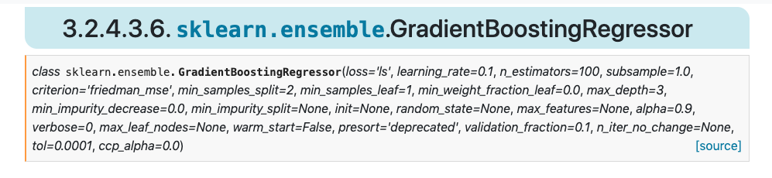
Learning trig through regression
6. iterate or ship
Iterate
Might be worth tweaking the algorithm parameters
This is where GAs can become very useful ;)

Slide 28

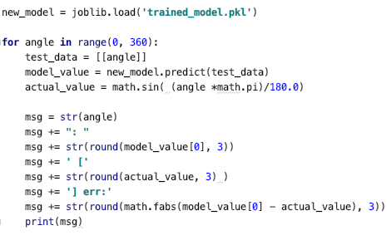
Learning trig through regression
7. Ship
Embed the model into an application
Save model data
Use model in app
Note generally gnarliness in using model, input data needs to be an array of arrays

Slide 29
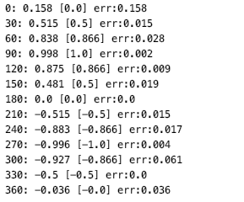
Learning trig through regression
7. Ship
Is the algorithm any good in the real world?
Test it and find out

Slide 30
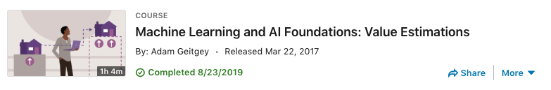
Learning through LinkedIn Learning
A lot of the process for this weeks’ lecture comes from
Machine Learning and AI Foundations: Value Estimations (Adam Geitgey)
Uses house prices as an example
Well worth having a watch (1hr)
You are all subscribed to LinkedIn Learning through your falmouth.ac.uk accounts
https://www.linkedin.com/learning/machine-learning-and-ai-foundations-value-estimations/overfitting-and-underfitting

Slide 31
Workshop

Slide 32
Workshop
This week, I want to have a look at:
Technical design to help you build applications
Using UML & Booch to better understand class architecture and game states
Using HTTP to manage data
Breakout as a regression-based learning model
Managing data

Slide 33
Do you have any questions for me

